Slide 1
Movie-BOT
Looking for a movie to watch?
We got you covered!

Slide 2
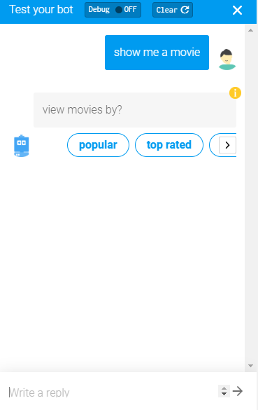
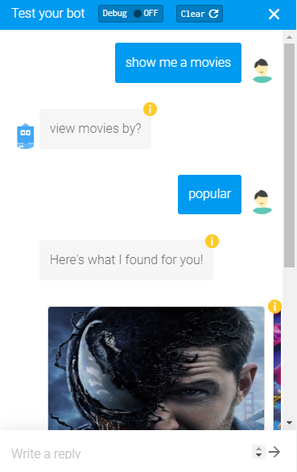
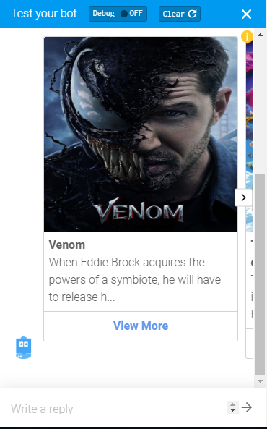
UseCase 1
Purpose – To show movies on basis of - Popular, top rated, now playing, up-coming categories.

Slide 3
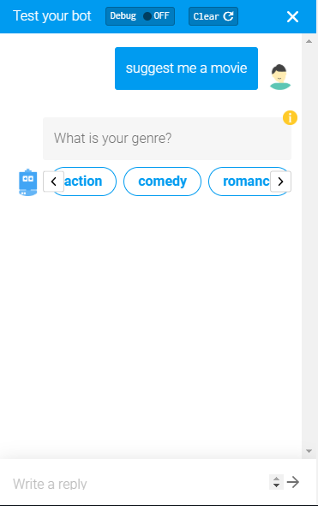
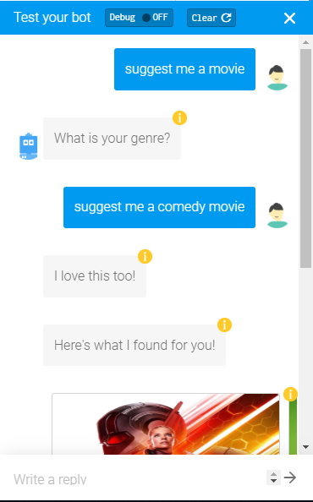
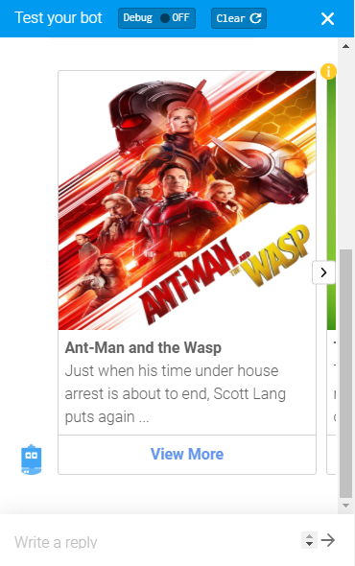
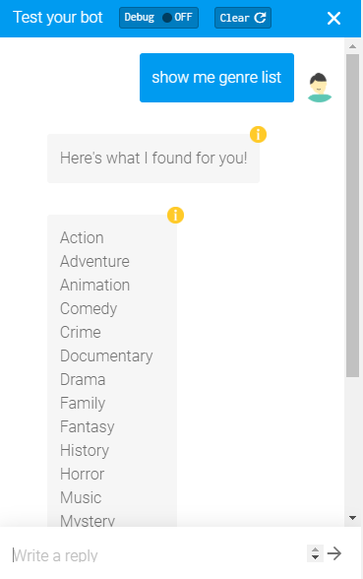
UseCase 2
Purpose – To show movies recommendation based on genre of a movie such as action, drama, comedy, romance etc.

Slide 4
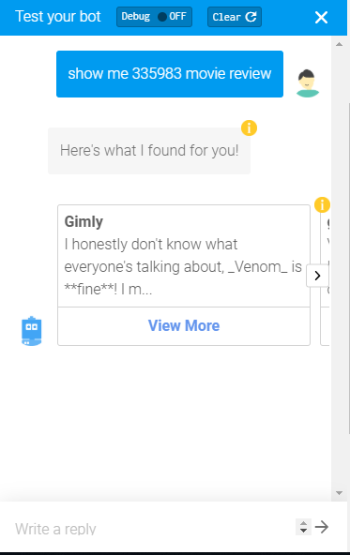
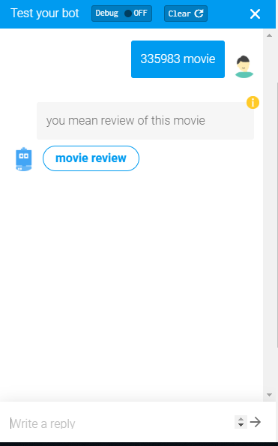
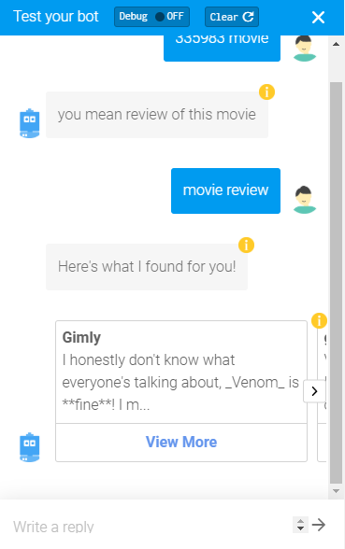
UseCase 3
Purpose – To show movie reviews for a particular movie.

Slide 5

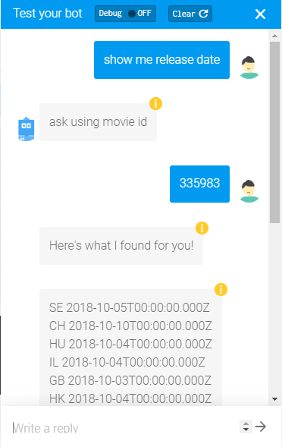
UseCase 4
Purpose – To show release date of a particular movie.

